Slide 1
Reducing uncertainties in estimating California's forest carbon stocks
Jonathan A. Greenberg, Geography and GIScience, UIUC
Bo Li, Statistics, UIUC
Carlos Ramirez, Remote Sensing Lab (R5), USDA FS

Slide 2
Primary Goals of the Project
Primary goal:
Estimate the mean tree-sequestered above-ground biomass for the state of CA for the period of 2005 to 2015 at 30m resolution using a variety of datasets and techniques.
Determine the spatially explicit uncertainty in these estimates.

Slide 3
Secondary Goals of the Project
Perform a full propagation of error analysis to investigate the impacts of uncertainties in:
Allometric equations
Species distribution modeling
Remote sensing products that link to allometrics
Fuse multiple AGB products together via a Bayesian Hierarchical Framework (allows for future products to be integrated).

Slide 4
Remote Sensing Aware Allometries
REMOTE SENSING CAN’T DIRECTLY DETECT DBH AND SPECIES (usually)
We will produce the following “remote sensing aware” allometric equations AND the error:
AGB + ε_{A} = f(spectra + ε_{RS1}) + ε_{B}
AGB + ε_{A} = f(% tree cover + ε_{RS2}) + ε_{C}
AGB + ε_{A} = f(stand age + ε_{RS3}) + ε_{D}
AGB + ε_{A} = f(per-tree crown height and area + ε_{RS4}) + ε_{E}
ABG + ε_{A} = f(crown area + ε_{RS5}) + ε_{F}

Slide 5
Remote Sensing Linking Variables
Data Source | Methods | AGB Linking Variable
Landsat (single date) | N/A | Reflectance Spectra
Landsat (single date) | Spectral unmixing | % tree cover
Landsat (time series) | Time series analysis | Stand age
Lidar | Individual tree crown mapping | Per-tree crown height and area
Worldview 2 & 3 | Individual tree crown mapping | Per-tree area

Slide 6
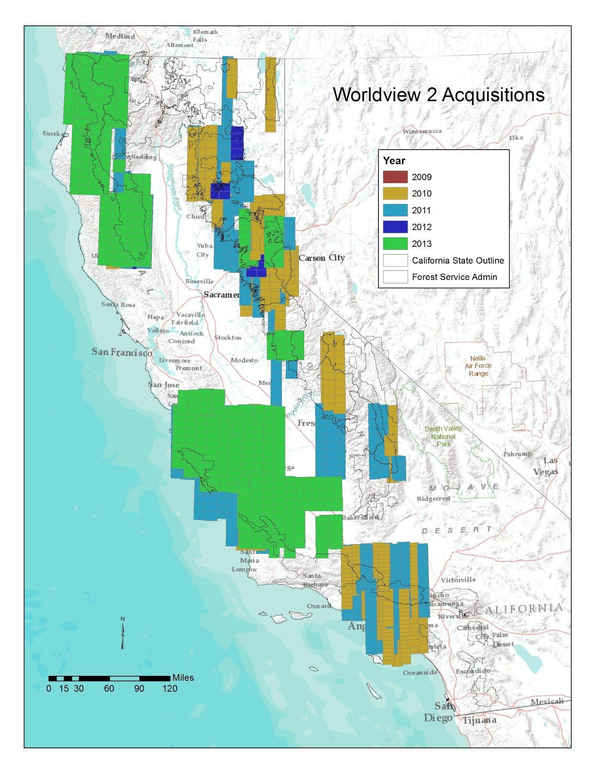
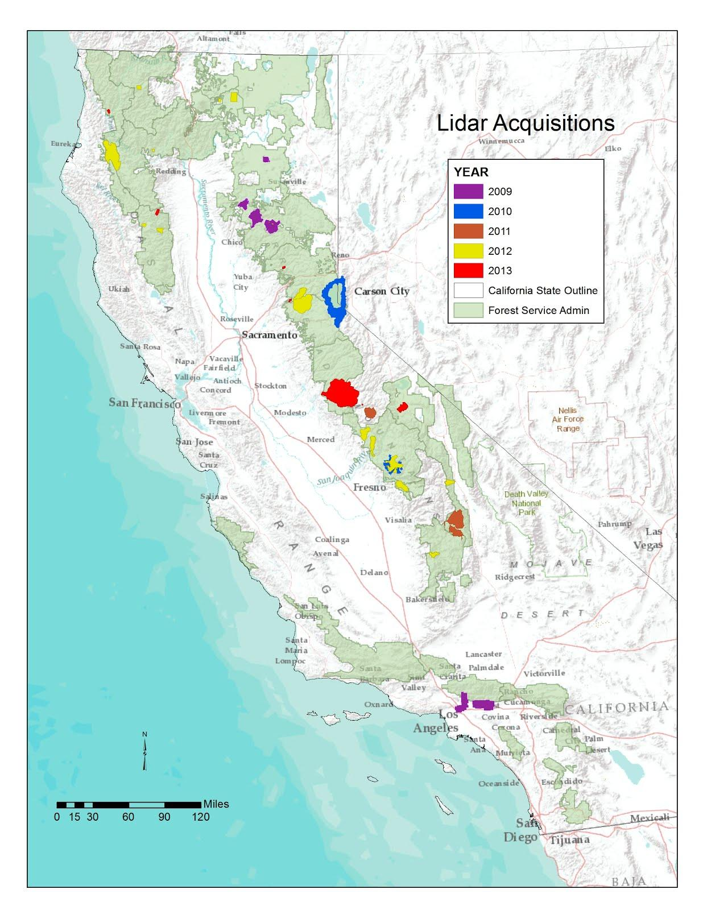
Available RS Data (as of 9/2014)

